Slide 1

CS4225/CS5425 Big Data Systems for Data Science
Assignment 2: Spark

Slide 2
Outline
Description of Assignment 2
Submission requirements

Slide 3
Task Overview
Motivation
OpenStreetMap(OSM) files are big data.
OSM files processing is useful for road navigation.
Get familiar with Spark.

Slide 4
Problem Description
Given an OSM file, you need to extract the nodes (i.e., positions) and edges(roads) information to construct a road graph.
Write an algorithm that can find the (shortest) path between any two nodes in the road graph.

Slide 5

Problem Description
Input
An OSM file that contains NUS road information, named as ‘NUS.osm’
A file named ‘input.txt’ that contains multiple node pairs. For each nodes pair, you need to find a path from the source node to the destination node.
For each nodes pair in input file, there is at least one path between them.
Input file1:
Source node
Destination node

Slide 6

Problem Description
Output 1
After constructing your road graph, you need to output the graph in adjacent list format.
In each line, you should output the id for a node, and the id for its outgoing neighbors. You should sort the outgoing neighbors in ascending order.
You should also sort all the lines in ascending order of the id.
1
3
If you construct a road graph as the left side, your output of the road graph should be:
2
4
The id for outgoing neighbors are in ascending order
5
The id for the first node in each line are in ascending order

Slide 7
Problem Description
Output 2
For each node pair in the input file, you need to output a directed path in one line.
The path should contain all the nodes in order included the source and destination nodes. The nodes should be connected by ' -> ' symbol.
100
1
3
If you construct a road graph as the left side, and the input nodes pair is '1 4', your output can be:
'1 -> 2 -> 4' or '1 -> 3 -> 4' .
1
1
2
1
4

Slide 8
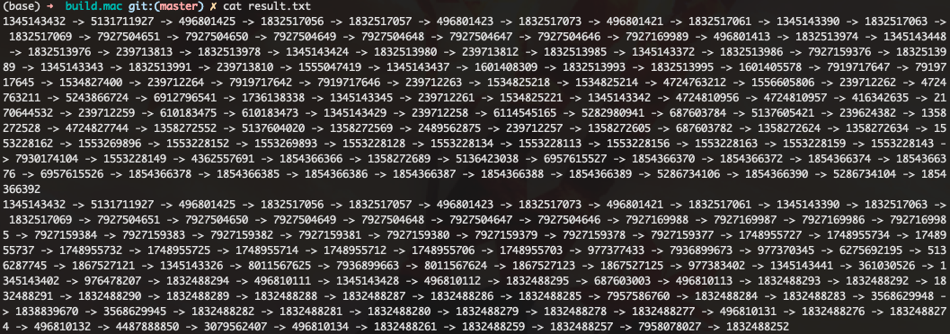
Problem Description
Output 2
For each node pair, you need to output a directed path in one line.
The path should contain all the nodes in order included the source and destination nodes. The nodes should be connected by ' -> ' symbol.
Example output of path for file1:

Slide 9
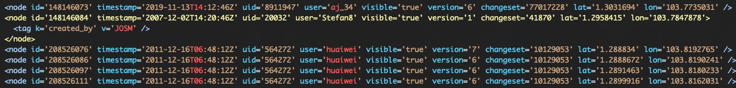
Problem Description
OSM file format
For this assignment, you only need to focus on two types of data, i.e., node data and road data.
A node data represents a location. It will start with '<node' and end with ‘/>' or '</node>', the id for each node is unique. You need to extract the id, latitude and longitude information for each node.
Node id
latitude
longitude

Slide 10
Problem Description
OSM file format
For this assignment, you only need to focus on two types of data, i.e., node data and road data.
A node data represents a location. It will start with '<node' and end with ‘/>' or '</node>', the id for each node is unique. You need to extract the id, latitude and longitude information for each node.
Node id
latitude
longitude

Slide 11
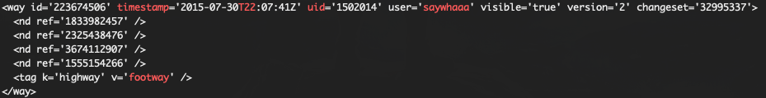
Problem Description
OSM file format
For this assignment, you only need to focus on two types of data, i.e., node data and road data.
A road data represents a way that connect multiple nodes. It will start with '<way' and end with '</way>', the id for each way is not unique.
For this assignment, we only consider the road data with a highway tag.
Road data with highway tag

Slide 12
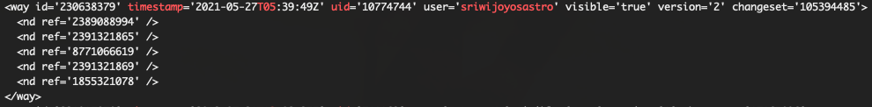
Problem Description
OSM file format
For this assignment, you only need to focus on two types of data, i.e., node data and road data.
A road data represents a way that connect multiple nodes. It will start with '<way' and end with '</way>', the id for each way is not unique.
For this assignment, we only consider the road data with a highway tag.
Road data without highway tag, you can ignore this road

Slide 13
Problem Description
OSM file format
For each road data, you need to extract all the nodes inside it. For each node, it will be reflected as <nd ref=’unique_id’ />.
Only the adjacent nodes in the road data are directly connected to each other.
A node with id ‘1833982457’
The final road graph of the example will be:
1883982457
23254382457
3674112907
1555154266

Slide 14
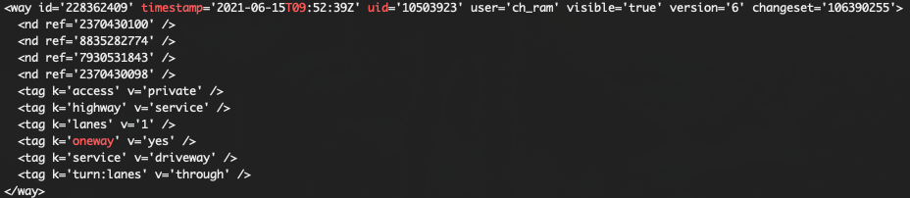
Problem Description
OSM file format
A road is one-way if it has a oneway tag, i.e., the road data contain a line: <tag k=‘oneway’ v=‘yes’ />.
The node in the road data is directly connected to node in the next line in one direction.
Oneway tag for the road
The final road graph of the example will be:
2370430100
8835282774
7930531843
2370430098

Slide 15
Problem Description
After constructing your road graph, you need to use the latitude and longitude information to calculated the length of every edge. You can use our supported distance function.
Edge_a
Edge_b
a, lat_a, lon_a
b, lat_b, lon_b
c, lat_c, lob_c
Edge_c
Length of edge_a = distance(lat_a, lat_b, lon_a, lon_b)
Length of edge_b = Length of edge_c = distance(lat_b, lat_c, lon_b, lon_c)

Slide 16
Problem Description
You need to use spark to design an algorithm that can find a path between any two nodes in the road graph.
Your algorithm should be able to find the result within 20 minutes using the soc cluster. We will stop your program if your codes run more than 20 minutes.
You should flush your result to the disk once you find the path for a test case, so that your buffered output won’t lost if we stop your program.

Slide 17
Problem Description
Hint: You can use some basic graph traversal algorithms such as DFS or BFS[1]. You can also use some algorithms that can find the single-source-shortest-path(SSSP), such as Dijkstra[2].
You can use spark-xml (version 2.12) and graphframe (version 2.12) package to help you design the algorithm. You can not use any other libraries except those two packages and the java, hadoop and spark native libraries.
[1] https://ocw.mit.edu/courses/electrical-engineering-and-computer-science/6-006-introduction-to-algorithms-fall-2011/lecture-videos/MIT6_006F11_lec13.pdf
[2] https://ocw.mit.edu/courses/electrical-engineering-and-computer-science/6-006-introduction-to-algorithms-fall-2011/lecture-videos/MIT6_006F11_lec16.pdf

Slide 18
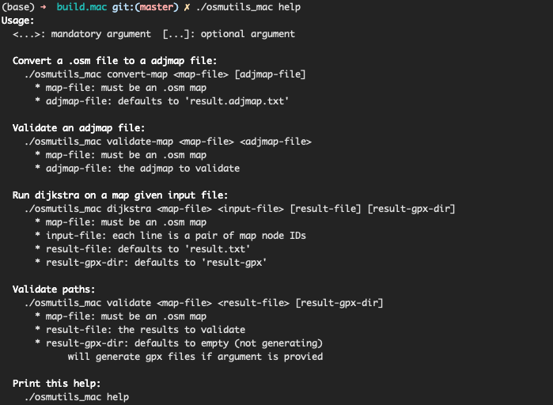
Problem Description
We support a tool name ‘osmutil’ to help you test your code. You need to choose the correct tool based on your current operating system. For example, if you are running your code on MacOS, you need to choose ‘osmutil_mac’.
You can use ‘./osmutil help’ to see the usage of the tool.

Slide 19
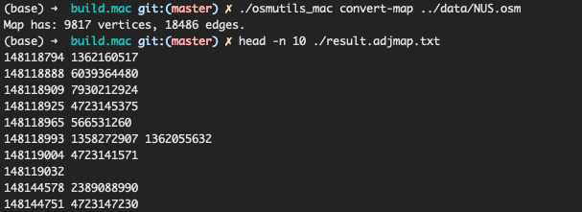
Problem Description
./osmutil convert-map <map-file> <adjmap-file> will output the map file in adjacent format. Your code should output the same map file if you want to pass the test case.

Slide 20

Problem Description
You can use ./osmutil validate-map <map-file> <adjmap-file> to check whether your output of the map is correct.
If your result is correct, the tool will print ‘valid’.
If your result is wrong, the tool will print ‘invalid’ along with your problems.
Your output is correct.
Your output misses one vertex.

Slide 21
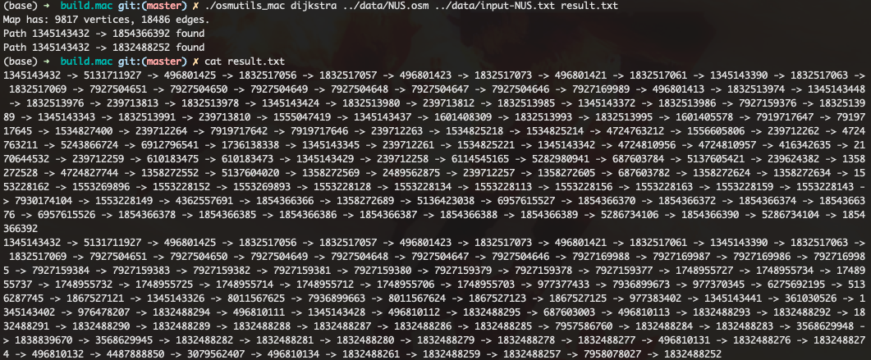
Problem Description
./osmutil dijkstra <map-file> <input-file> will find a pseudo-path for each nodes pair in the input file. Your code should give a path same to or shorter than the pseudo-path.

Slide 22

Problem Description
You can use ./osmutil validate <map-file> <result-file> to check whether your output of path is valid, i.e., there does exist such path.
If your result is valid, the tool will print the line that begins with ‘valid’ and followed by the length of your result path.
The length for the first path

Slide 23

Problem Description
You can use ./osmutil validate <map-file> <result-file> to check whether your output of path is valid, i.e., there does exist such path.
If your result is invalid, the tool will print the line that begins with ‘invalid’.
The output of first path is invalid.

Slide 24
Submission Requirements
Deadline: Apr. 3rd
Submit the file FindPath.java into the folder AssignmentSubmission/Assignment2 in Luminus.
When submitting, make sure you only modify and submit the file FindPath.java.
Policy on late submission:
Code submitted after the deadline but no more than 48 hours after the deadline will still be graded, with a penalty of 20%, i.e., multiple 80% of your original mark.
Code submitted more than 48 hours after the deadline will not be accepted and will get 0 mark.

Slide 25
Marking
All the codes will be automatically compiled and marked by similar scripts as 'compile_run’ using ten test cases
The test cases will contain the five public cases we give to you and five private test cases that are simpler than the public test cases.
So, ensure your codes can be compiled by the script in your package.
All submitted codes will be auto-checked for plagiarism. Do NOT copy others' codes or share your codes with others.
The environment we use for marking will be the same as the one you use for testing your code, i.e., a cluster with ten servers.

Slide 26
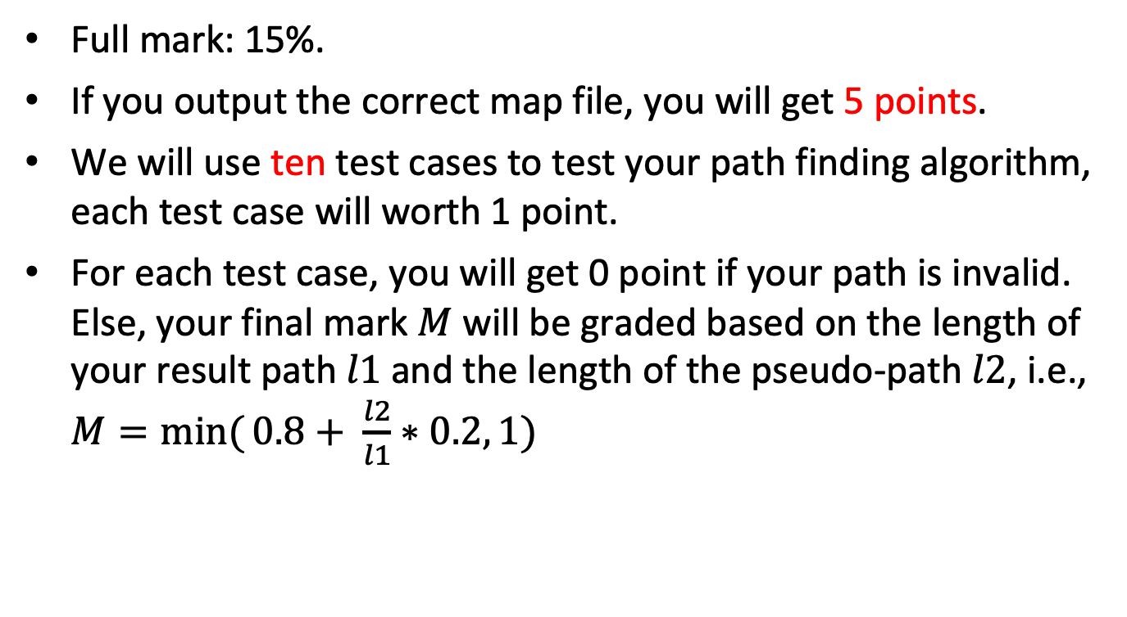
Marking
Full mark: 15%.
If you output the correct map file, you will get 5 points.
We will use ten test cases to test your path finding algorithm, each test case will worth 1 point.
For each test case, you will get 0 point if your path is invalid. Else, your final mark $M$ will be graded based on the length of your result path $l1$and the length of the pseudo-path $l2$, i.e., $M=\min{(}0.8+ \frac{l2}{l1}∗0.2, 1)$

Slide 27
Notice
We have zero-tolerance on plagiarism.
Do not “Copy and paste” from others.
Do not share your code with others.

Slide 28
Feedbacks are Welcome
Email: Mr. Yuhang Chen, e0546081@u.nus.edu
Mr. Sixu Hu, e0409758@u.nus.edu
Or, post your questions in the LumiNUS forum (preferred).
You may find something useful from FAQ of last semester, which can be found in the attached student guide. Note: we have change the format of our assignment this year (thus this FAQ is just for your reference).

